Slide 1
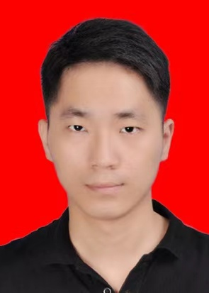
Zhen Li (Zhen.Li@hud.ac.uk https://orcid.org/
0000-0002-4491-6972
Title: Characterising Acoustic Emission of Additive Manufacturing for Online Quality Control
Work done | On going work
Have an understanding of fault diagnosis and condition monitoring of the additive manufacturing. Have a learning of the principle and operation of acoustic emission acquisition system. Proposed a method of creating model printing process model by digital instruction. | Using acoustic emission method to have condition monitoring in 3D printing process. Explore the relationship between the digital model and the vibration signals in the actual printing process.
Achievements
Li Z., Zhou X., Bao F., Gu F., Ball A.D.. A Review of Acoustic Emission Monitoring on Additive Manufacturing. TEPEN 2021.

