Slide 1
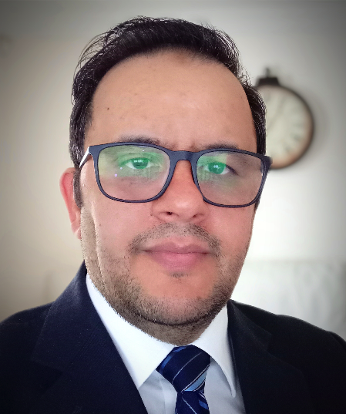
Khalifa Bllau (https://orcid.org/0000-0002-6045-0922)
Khalifa.bllau@hud.ac.uk
Title: Web-based system for monitoring tool wear development in turning operation and its implementation and application perspectives.
Previous work | On going work
Analyzed that the relationship between Acoustic Emission (AE) signal and tool wear development in turning process. Confirmed that AE can be used to monitor the turning machining operations. Demonstrated that multi-regression model based on the average of AE signal and cutting parameters are reliable indicators of the tool wear development in turning process. Developed a web-based interface using PHP programming language & Fog computing for remote monitoring of the tool wear. | To carry out more theoretical research on modelling tool wear and fog computing. To establish an accurate physical model, providing theoretical support for future experiments. To develop advanced data analysis techniques，enhancing AE characteristics for more reliable diagnostics of tool wear development in turning process. To establish best practice of fog computing integration with the monitoring models.
Outputs
On progress to publish first paper

